Slide 1


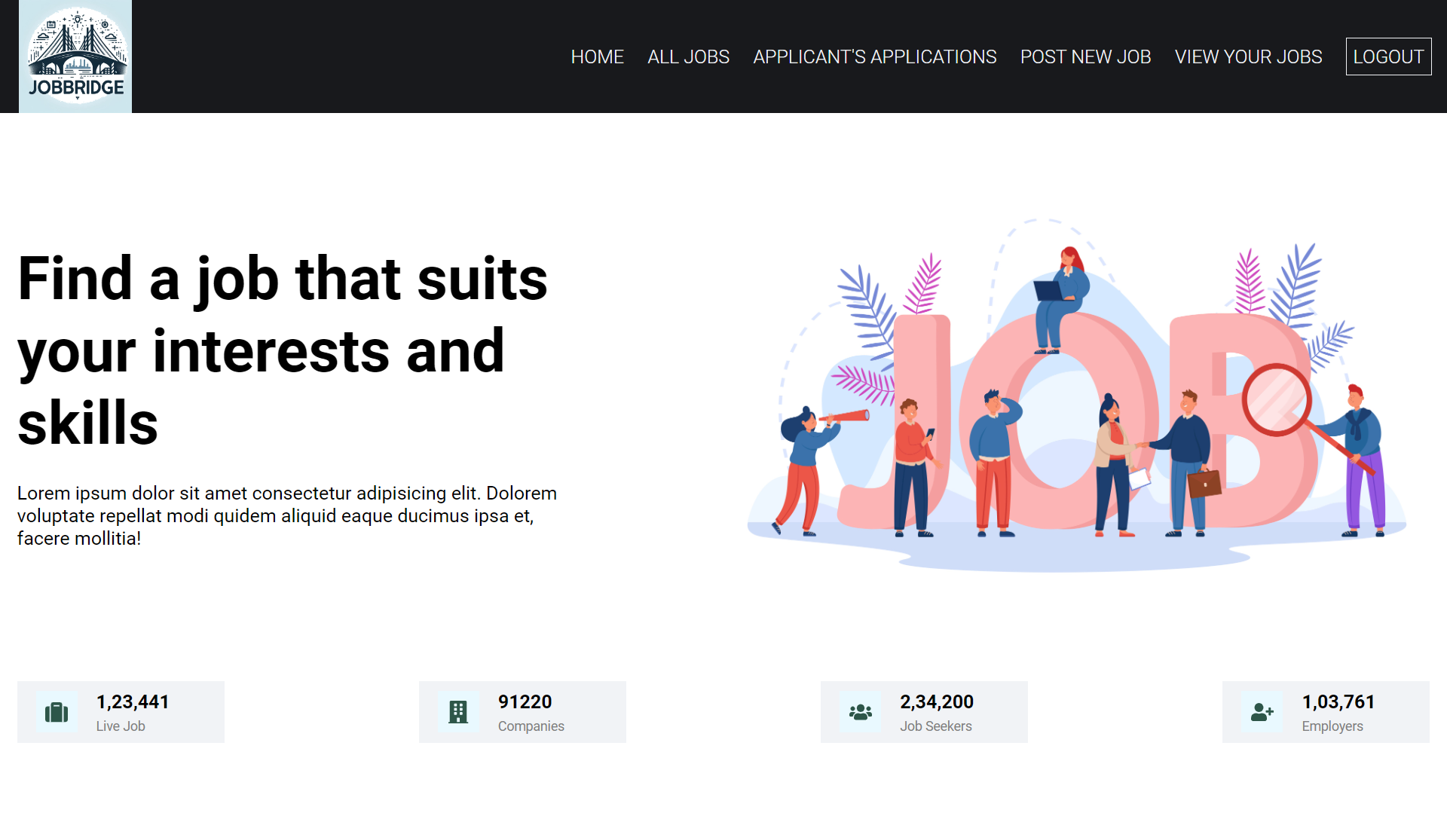
DEPARTMENT OF COMPUTER
ENGINEERING AND APPLICATIONS
JobBridge : Connecting Employers And Job Seekers
Ayush Srivastava
Nishant Sharma
Rishit Gupta

Slide 2

Introduction
1.
Welcome to JobBridge, an innovative job board platform that connects employers with top talent. Our mission is to streamline the hiring process and empower both job seekers and employers to find the perfect match.
2.
The platform offers a user-friendly interface and advanced search features, making it easy for employers to post job openings and for job seekers to find their dream job. JobBridge is dedicated to helping individuals at all career stages, from recent graduates to experienced professionals, take the next step in their career journey.

Slide 3

Objectives
1
User-Friendly Platform
Develop a platform that efficiently connects employers with qualified candidates,
ensuring a seamless hiring process.
2
Advance Search
Implement features that allow job seekers to easily find relevant opportunities through advanced search
3
Streamlined Application Process
Enhance the application process to minimize friction and improve the experience for both Job seekers and employers.

Slide 4

Problem Statement
Despite the abundance of job postings and a large pool of qualified candidates, the current job search process is often inefficient and frustrating for both employers and job seekers. Employers struggle to find the right talent, while job seekers face difficulties in navigating the vast job market and navigating the often cumbersome application process. This mismatch between supply and demand in the job market leads to prolonged vacancies, high hiring costs, and missed opportunities for both parties.

Slide 5
Literature Review
Extensive research has been conducted on the challenges facing the job market and the need for innovative platforms to connect employers and job seekers. Studies highlight the inefficiencies in traditional job search and hiring processes, leading to prolonged vacancies and missed opportunities.
The gap that JobBridge is bridging is the absence of a streamlined and effective platform for job seekers and employers. With JobBridge, individuals can effortlessly explore job listings and employers can find suitable candidates with ease. The portal is engineered to be intuitive and accessible, ensuring that the process of job hunting and recruitment is as smooth as possible for all users.
.

Slide 6
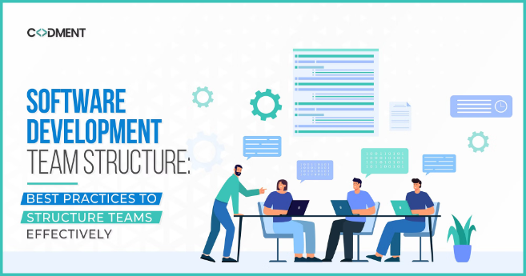
Methodology
Our methodology for the JobBridge project involves a multi-pronged approach. We will conduct extensive user research to deeply understand the pain points and needs of both employers and job seekers. This will inform the design and development of a robust, user-centric job board platform.
We will leverage agile software development practices, iterating quickly and seeking user feedback at every stage. Our team will also analyze industry best practices and cutting-edge technologies to ensure JobBridge remains at the forefront of innovation in the job market space.

Slide 7
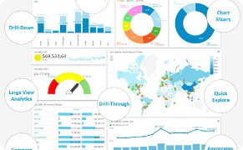
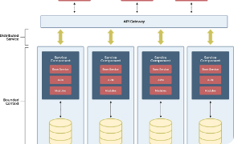

System Architecture
Modular Design
Technology Stack
Scalable Infrastructure
JobBridge utilizes a three-tier architecture with separate layers for the frontend (user interface), backend (server logic), and database (data storage), ensuring a clear separation of concerns and easier maintenance.
The platform is built using HTML, CSS, JavaScript, and React for the frontend, Node.js and Express.js for the backend, and MongoDB
for the database,
providing a modern and efficient development environment.
The JobBridge platform is designed with scalability in mind, using cloud services for hosting, which allows for easy expansion and resource management as the user base grows and the demand for services increases.

Slide 8
Implementation
1
Agile Development
2
Cloud-Native Infrastructure
3
Data-Driven Insights
We adopted an agile software development methodology, enabling us to respond quickly to changing requirements and user feedback through iterative sprints.
By leveraging cloud-based services and containerization, we were able to rapidly deploy and scale the JobBridge platform as demand grew.
Robust data analytics and reporting capabilities were integrated to provide employers and job seekers with real-time insights to guide their decisions.

Slide 9
Features
Comprehensive Job Listings
Employer Branding
JobBridge offers a vast database of job postings from a diverse range of industries and employers, catering to a wide array of job seekers.
Employers can showcase their company culture and values through customizable profiles, attracting top talent and building a strong employer brand.
Streamlined Application Process
Authentication
With a user-friendly interface and intuitive application flow, JobBridge simplifies the process of applying for jobs, reducing friction for both candidates and employers.
Users can register / login via their credentials (Emails , Password)

Slide 10
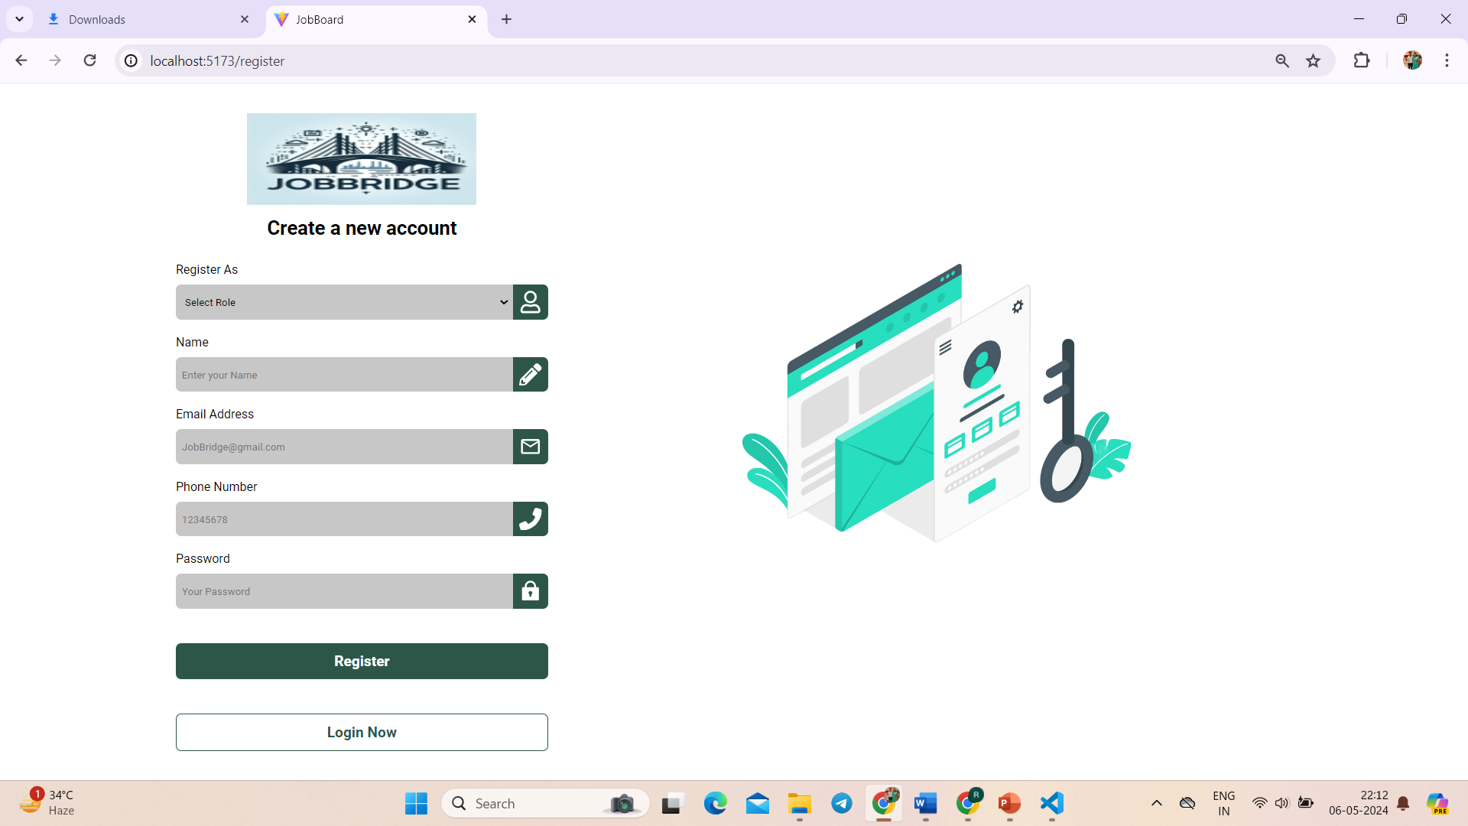
Results

Slide 11
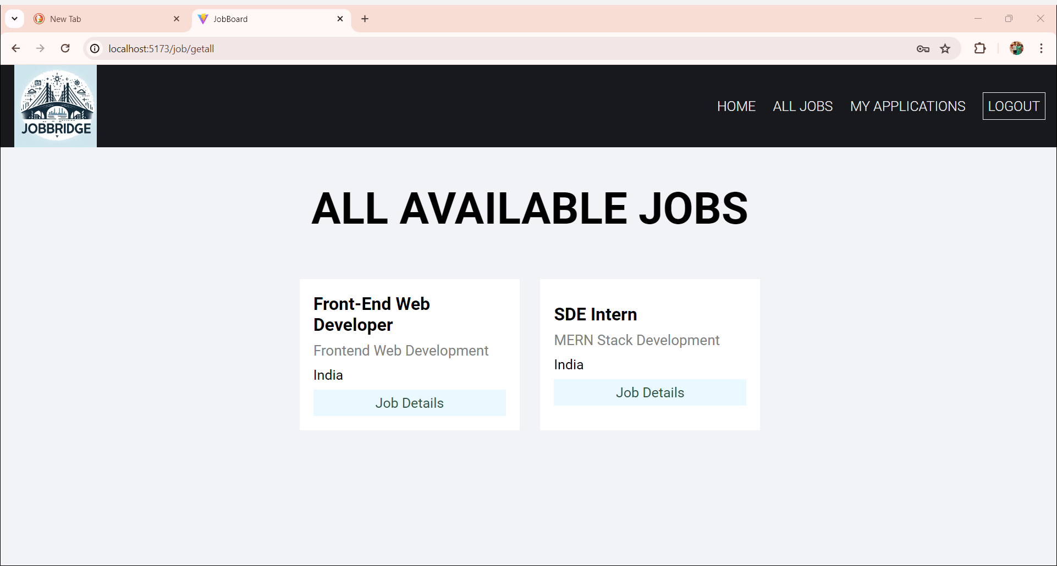
JobBridge is a streamlined platform for job seekers to find ideal roles and for employers to discover top talent. Job seekers can easily search and track listings, while employers post vacancies and connect with candidates. Both benefit from real-time alerts, ensuring no opportunity or applicant goes unnoticed. JobBridge simplifies the path to professional success.

Slide 12

Challenges Faced
Technical Complexity
Changing Job Market
Developing a scalable, secure, and user-friendly job platform requires overcoming significant technical hurdles in areas like cloud infrastructure, data management, and user interface design.
The job market is constantly evolving, with shifting trends, new skill demands, and emerging technologies. Keeping the platform up-to-date and relevant is an ongoing challenge.
User Adoption
Regulatory Compliance
Encouraging both employers and job seekers to actively use the platform and take advantage of its features is crucial but can be a significant hurdle to overcome.
Navigating the complex legal and regulatory environment surrounding hiring and employment data requires extensive research and careful implementation to ensure compliance.

Slide 13

Future Work
1
Multi-Language Support
We plan to implement multilingual support to expand our user base and cater to a wider market.
Additional Features
2
Collaboration Tools: Integrate tools for communication between job seekers and employers, such as messaging or video conferencing.

Slide 14

Conclusion
This project aims to bridge the gap between job seekers and employers by providing a comprehensive platform for job listings and applications. With advanced features and user-friendly interfaces, we aim to make the job search and application process seamless and efficient.

Slide 15
Acknowledgments
We would like to express our gratitude to all the individuals and organizations who have contributed to the development of JobBridge. Your support and feedback have been invaluable in shaping the features and functionality of our job-Portal app.

Slide 16


Slide 17


